Slide 1

Chatting Application at Institute of Management And Technology.
Nitesh Singh
2202840100141

Slide 2

Topics Covered
Programming using Java and Java Swing
Functions
Loops
Conditional Statements
Data Types

Slide 3
Introduction
A Chatting application shows the real time chat.
Its is end to end encrypted application.
The Web application is build using Java Swing and AWT .

Slide 4
Methodology
Java Programming Language: We are used Java for coding the logic and displaying the GUI with the help of Swing.
Standard Java Libraries: Utilize functions from standard libraries to work with time and user input.
Code Editor: Using NetBeans
Code Editor: visual studio code.

Slide 5
Flow of Message Exchange in the Application
Here’s a conceptual flow of how the chat application will work:
Step 1: The user enters a message into the JTextField.
Step 2: The user clicks the "Send" button (or presses Enter), triggering an event handler that processes the message.
Step 3: The message is displayed in the JTextArea and sent to the server.
Step 4: The server receives the message and sends it to the intended recipient (another client).
Step 5: The recipient's client receives the message and displays it in their JTextArea.
This flow is repeated for every message exchanged between users.

Slide 6
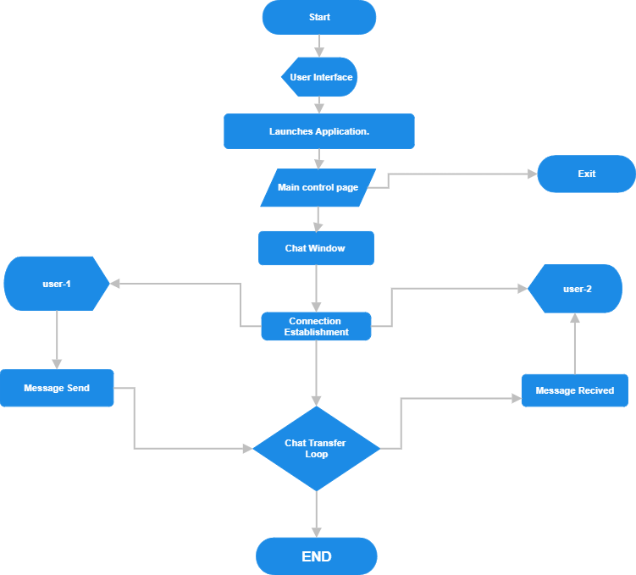
Flow-Chart

Slide 7
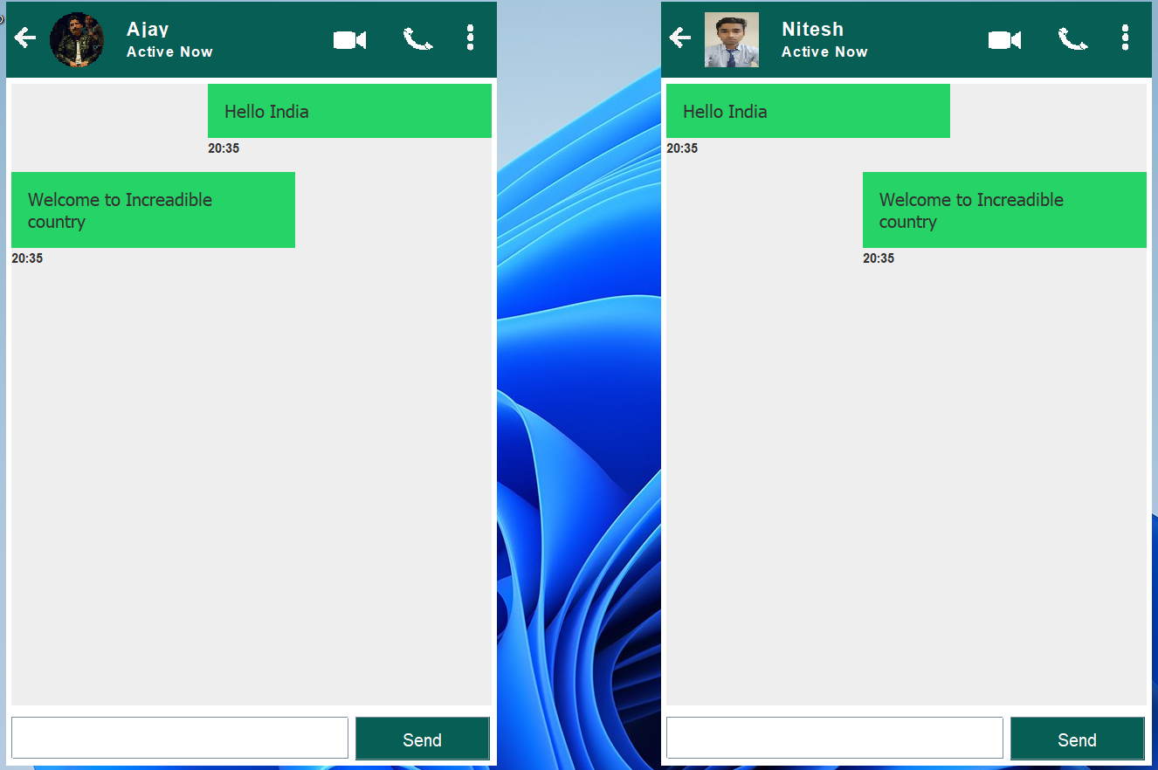
Results / Snapshots

Slide 8
Limitations
This is the GUI Based Web Chatting application.
It can only Use for text Chat.
It Can’t be used for transfer or forward File and text.
It’s only limitation to chat with text.

Slide 9
Future Scope
Web Chatting application can be used as full features like :File transfer and online chatting from across the world.
It can be making more user friendly.
We can use multiple features as : Status, Calling, etc.
It Can be developed for group chatting.

Slide 10
References
https://github.com/kunaltyagi9/chatting-application/blob/master/Chatting%20Application/src/chatting/application/Server.java
Programming with Java by E. Balagurusamy
.
Faculty Support: Bhadrinath Pratap Singh

